Slide 1

TITLE SLIDE
FOOD-STAT
THEME: STUDENT INNOVATION
TEAM NAME: JAILHOUSE ROCK
Shubh Pundir (22CSU165)
Vikas Kumar (22CSU190)
Shivesh Kumar Dhiman(22CSU164)

Slide 2






Problem Statement: Personalized Food Scoring & Recommendation System for Diverse Lifestyle
SOLUTIONS
PROBLEMS
Consumers struggle to make informed choices about packaged food due to overwhelming options and inconsistent food label information.
Different user groups (gym-goers, regular lifestyle maintainers, infants, and pregnant mothers) have specific nutritional needs, but existing solutions don't cater to personalized dietary goals.
There is a lack of real-time, personalized food scoring systems that consider individual health metrics, dietary preferences, and lifestyle categories.
Consumers need a solution to help them evaluate food products based on:
Real-time Food Label Scanning
Dietary Plan
Integration
Lifestyle-Based Recommendations
Scan nutrition labels and ingredients using EasyOCR
Personalized balanced diet plans
Tailor recommendations for gym goers, maintenance, infants and pregnant mothers
Health & Ingredient-Based Ratings
AI-Driven Food Compatibility Score
Custom Food Filters
Custom Machine Learning Algorithms to assign food ratings
Implement a ML framework based on Age, Sex, Height, Weight, Dietary preferences
Create custom food filters based on allergies, preferences, or intolerances

Slide 3
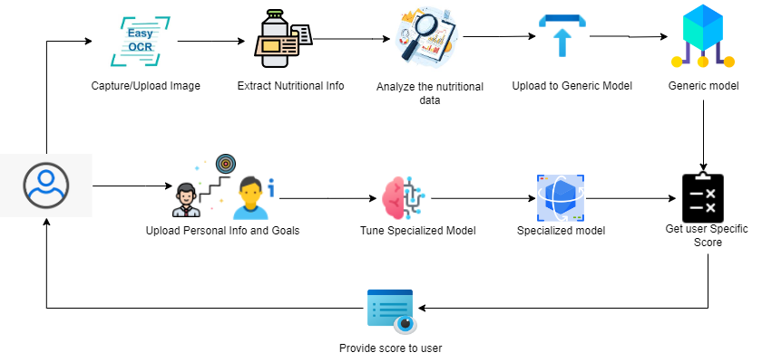





USER FLOW PROCESS
Frontend
DataBase
NextJS
MongoDB
Backend
APIs Used
Flask
EasyOCR
Pytorch

Slide 4
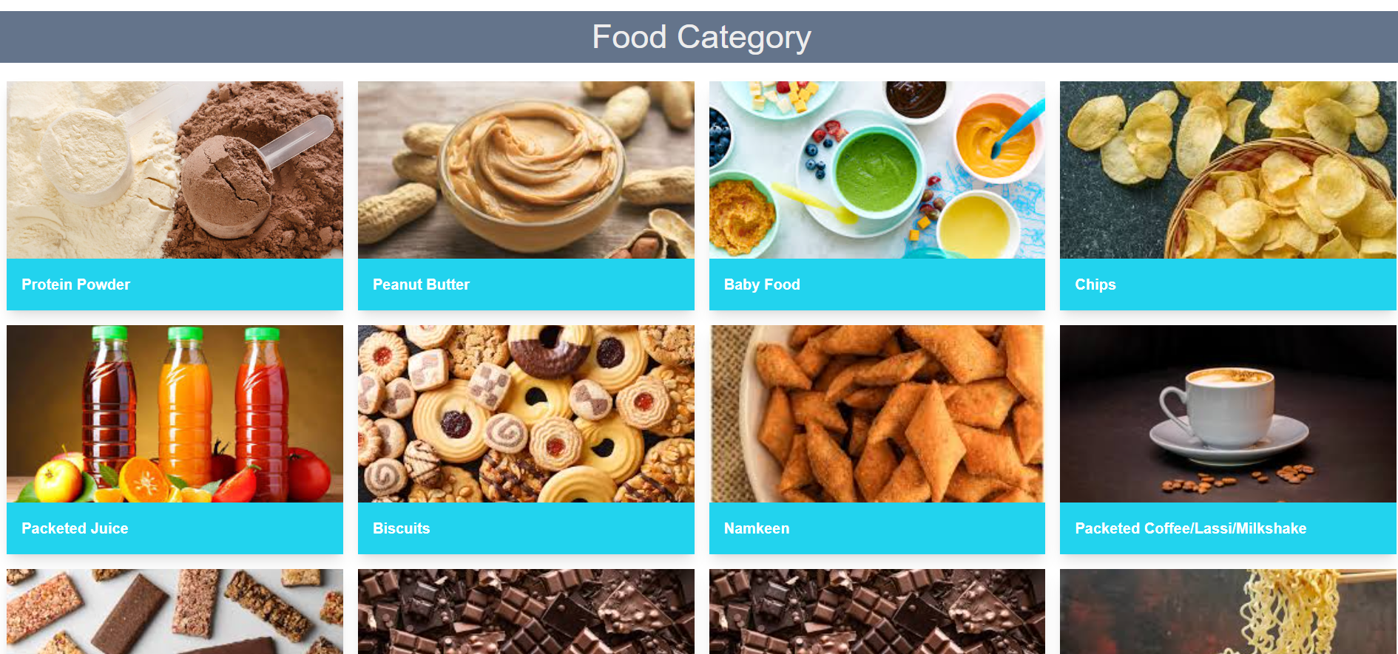
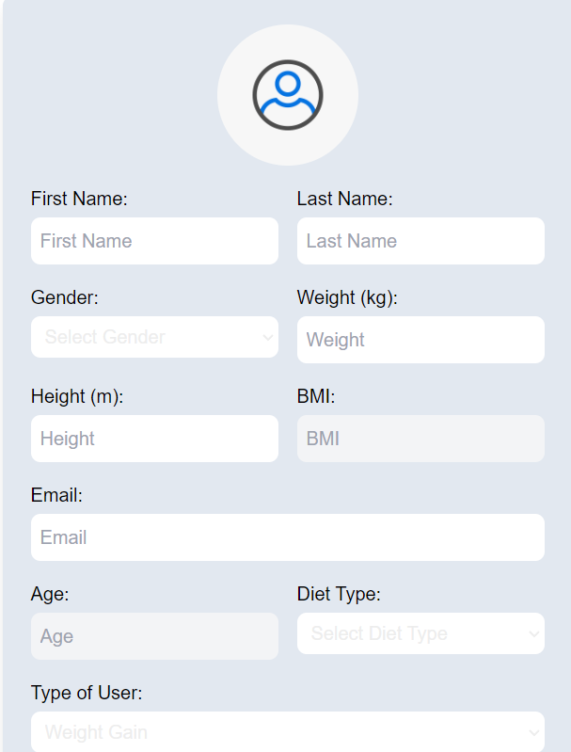

Slide 5



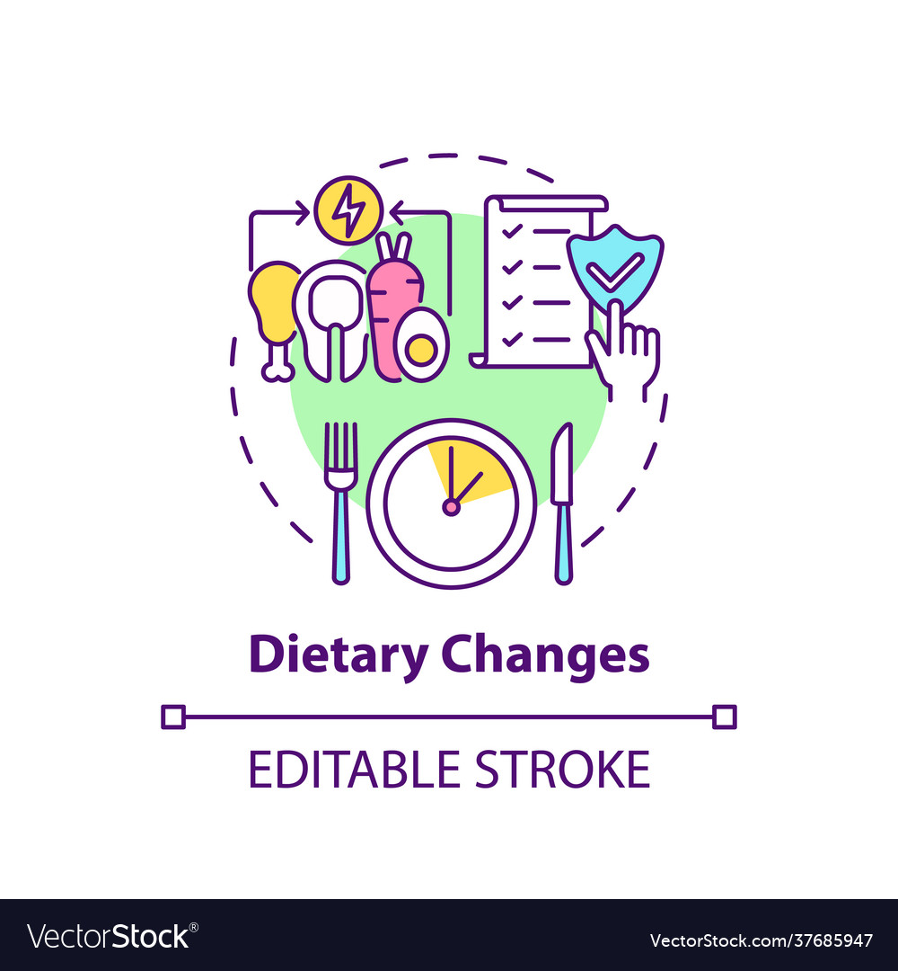


Convenience
Better Food Quality & Ingredient Transparency
Wide Audience with Diverse Lifestyle
Users can instantly evaluate food items while shopping, making it easier to choose healthier alternatives on the go
Highlights ingredient quality and health impact, pushing users toward foods with cleaner, safer ingredients.
Gym-goers, maintenance, infants, and pregnant mothers with specialized recommendations and scores.
User Awareness
Improved Diet & Fitness Outcomes
Integration with Wearable Devices
Increased dietary awareness and trust the food they consume
Assists users in staying on track with their fitness goals (muscle gain, weight loss, etc.) by recommending foods and creating personalized diet plans.
Integration with smartwatches and fitness brands to personalize and dynamically track the progress of the user

Slide 6
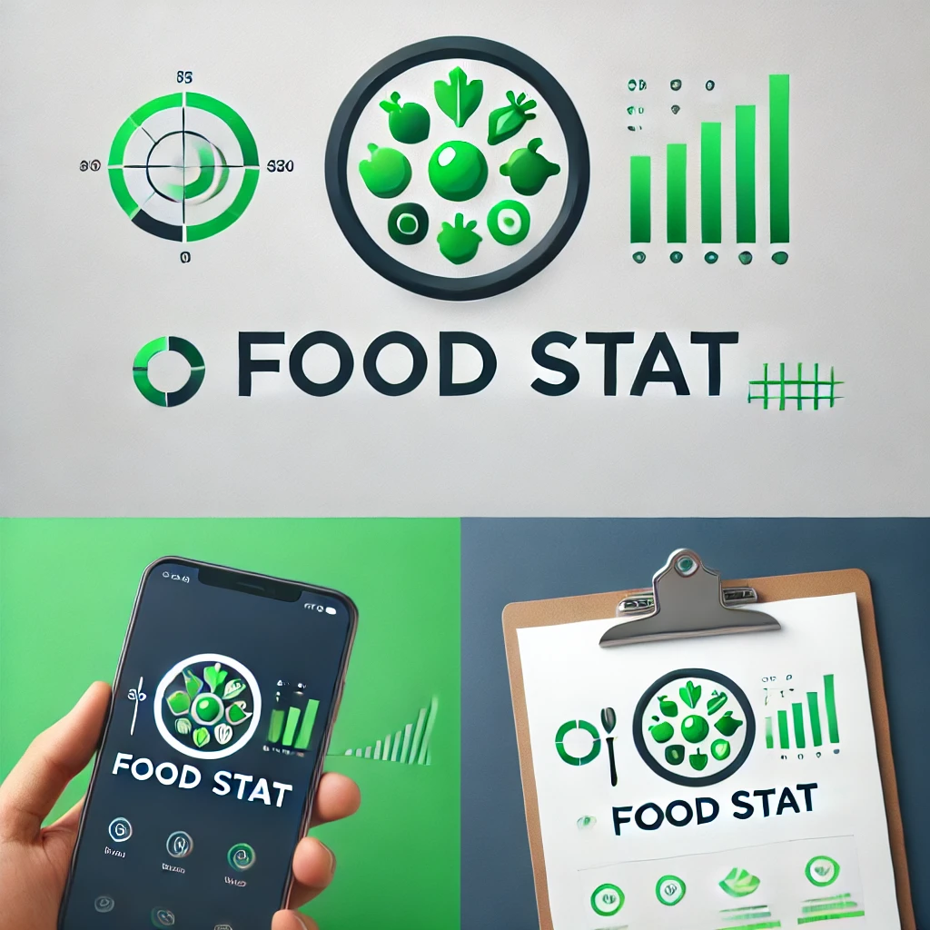
FOOD-STAT
PROS
DF
Personalized Recommendations
Real time Food Label Analysis
Diverse User Categories
Convenient and User Friendly Shopping Experience
“With Food Stat, we are not just building an app — we are empowering individuals to take control of their health, one food choice at a time. By combining the power of real-time technology, personalized recommendations, and transparent nutrition data, we aim to transform everyday shopping into a journey
toward better health and
sustainability.
CHALLENGES
Developing a Robust OCR System
Data Quality and Standardization
User Experience Optimization
Personalization Complexity

